Slide 1
Avidity Investigation

Slide 2
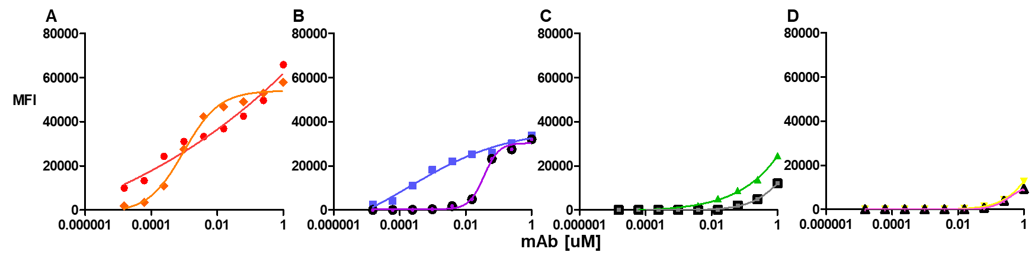
1.4nm
13nm
90nm
?
Antibodies able to bind for an hour before cells are washed
PD1 receptor number is approximately 1000

Slide 3
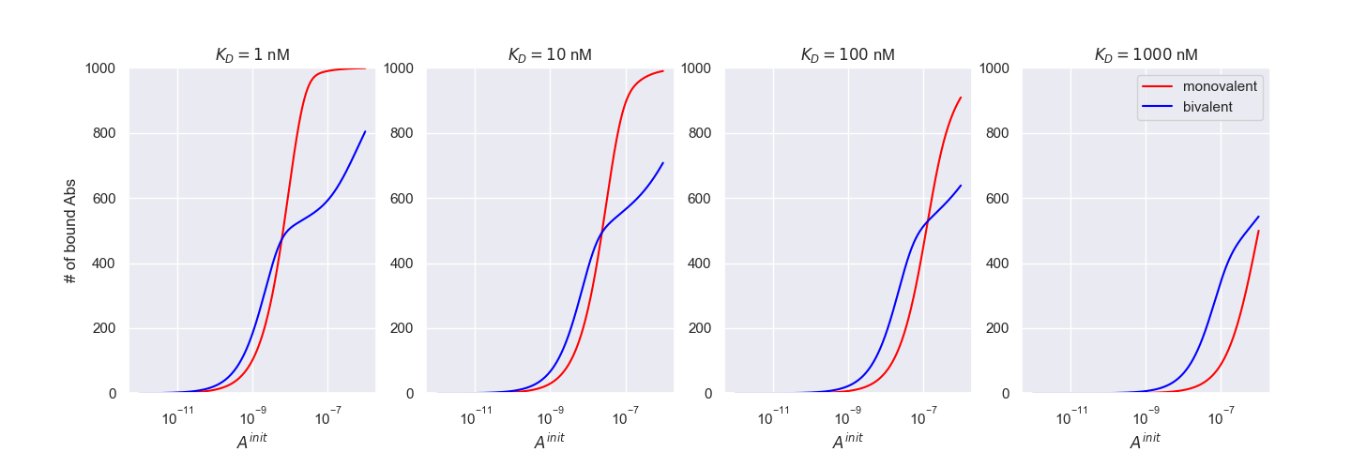
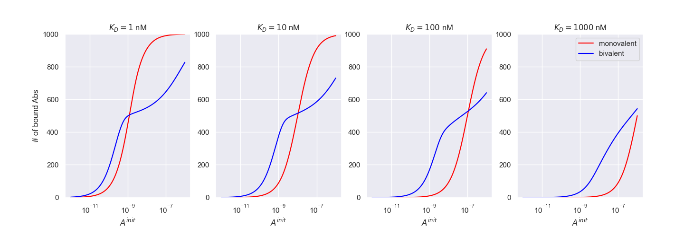
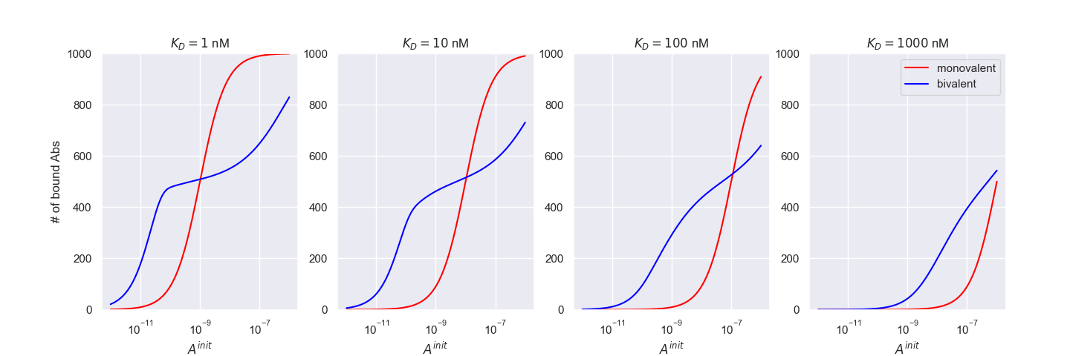
1 hour
10 hours
100 hours

Slide 4
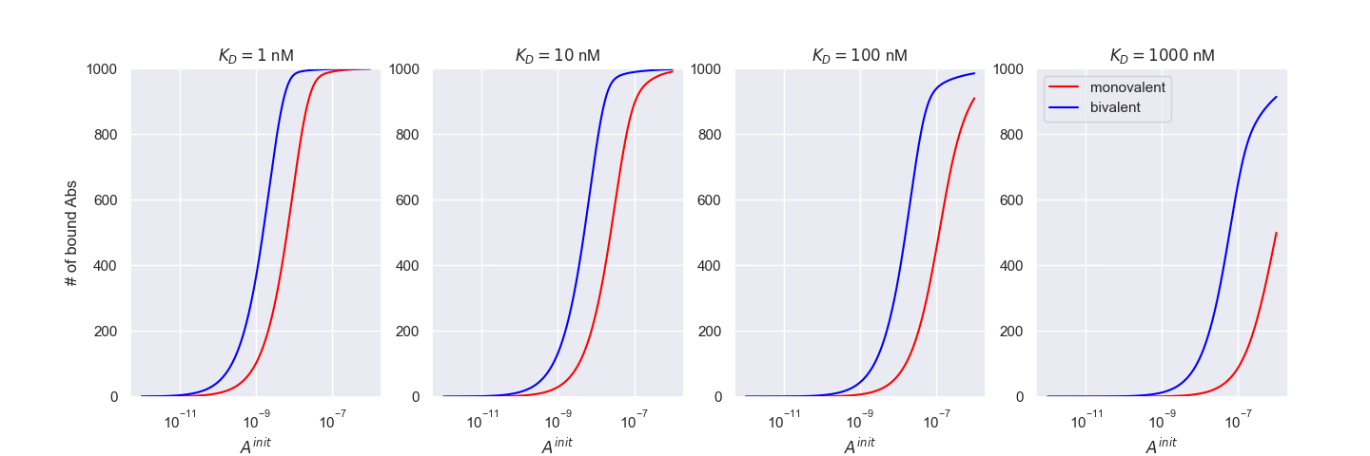
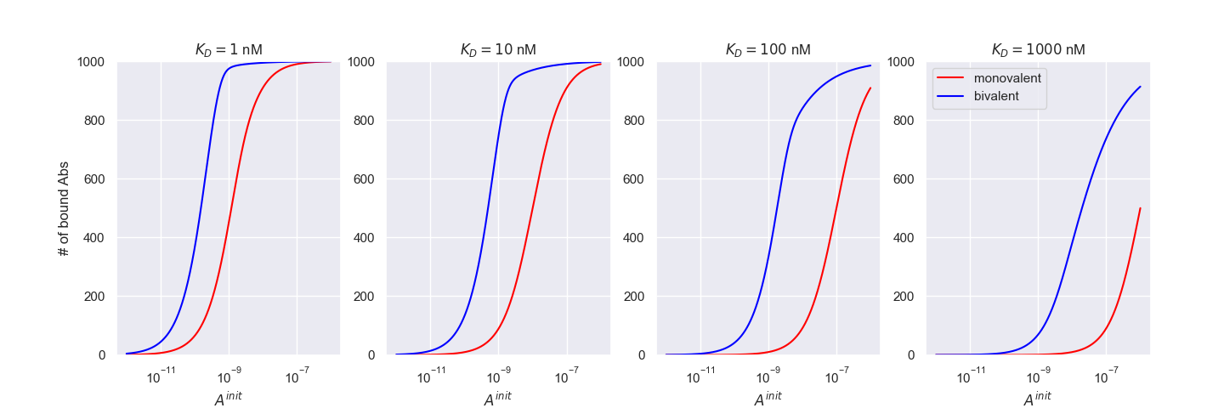
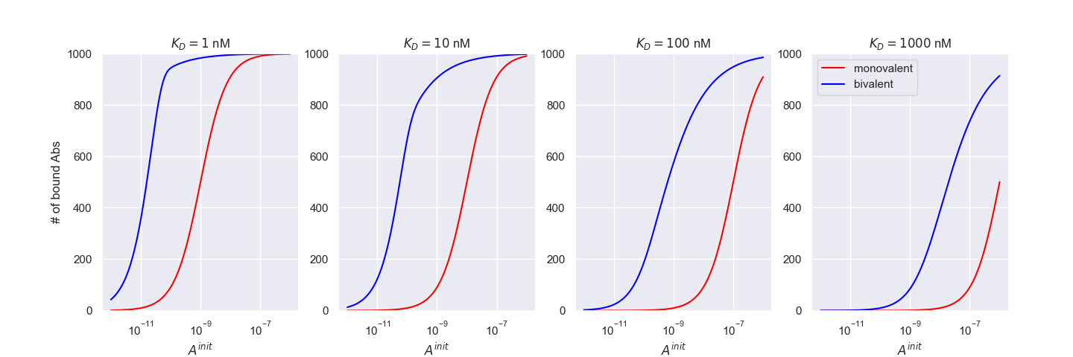
1 hour
10 hours
100 hours

Slide 5
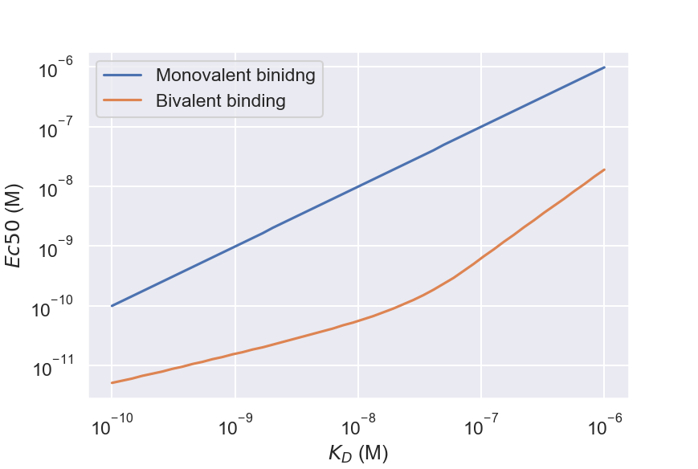
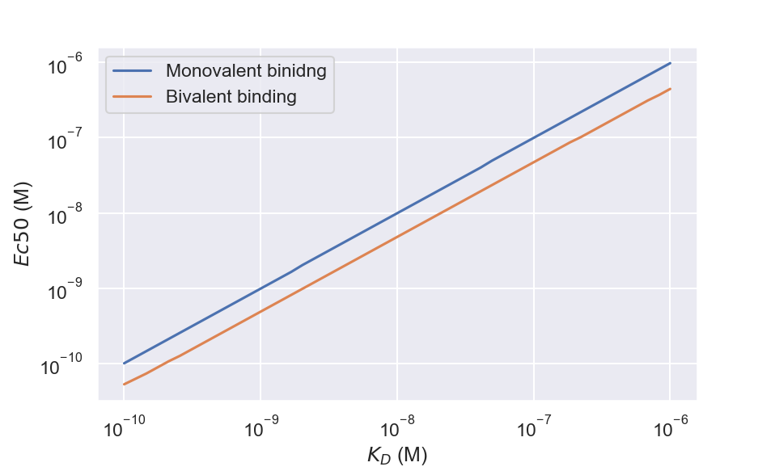
Receptor Occupancy
Number of bound antibodies

